Slide 1
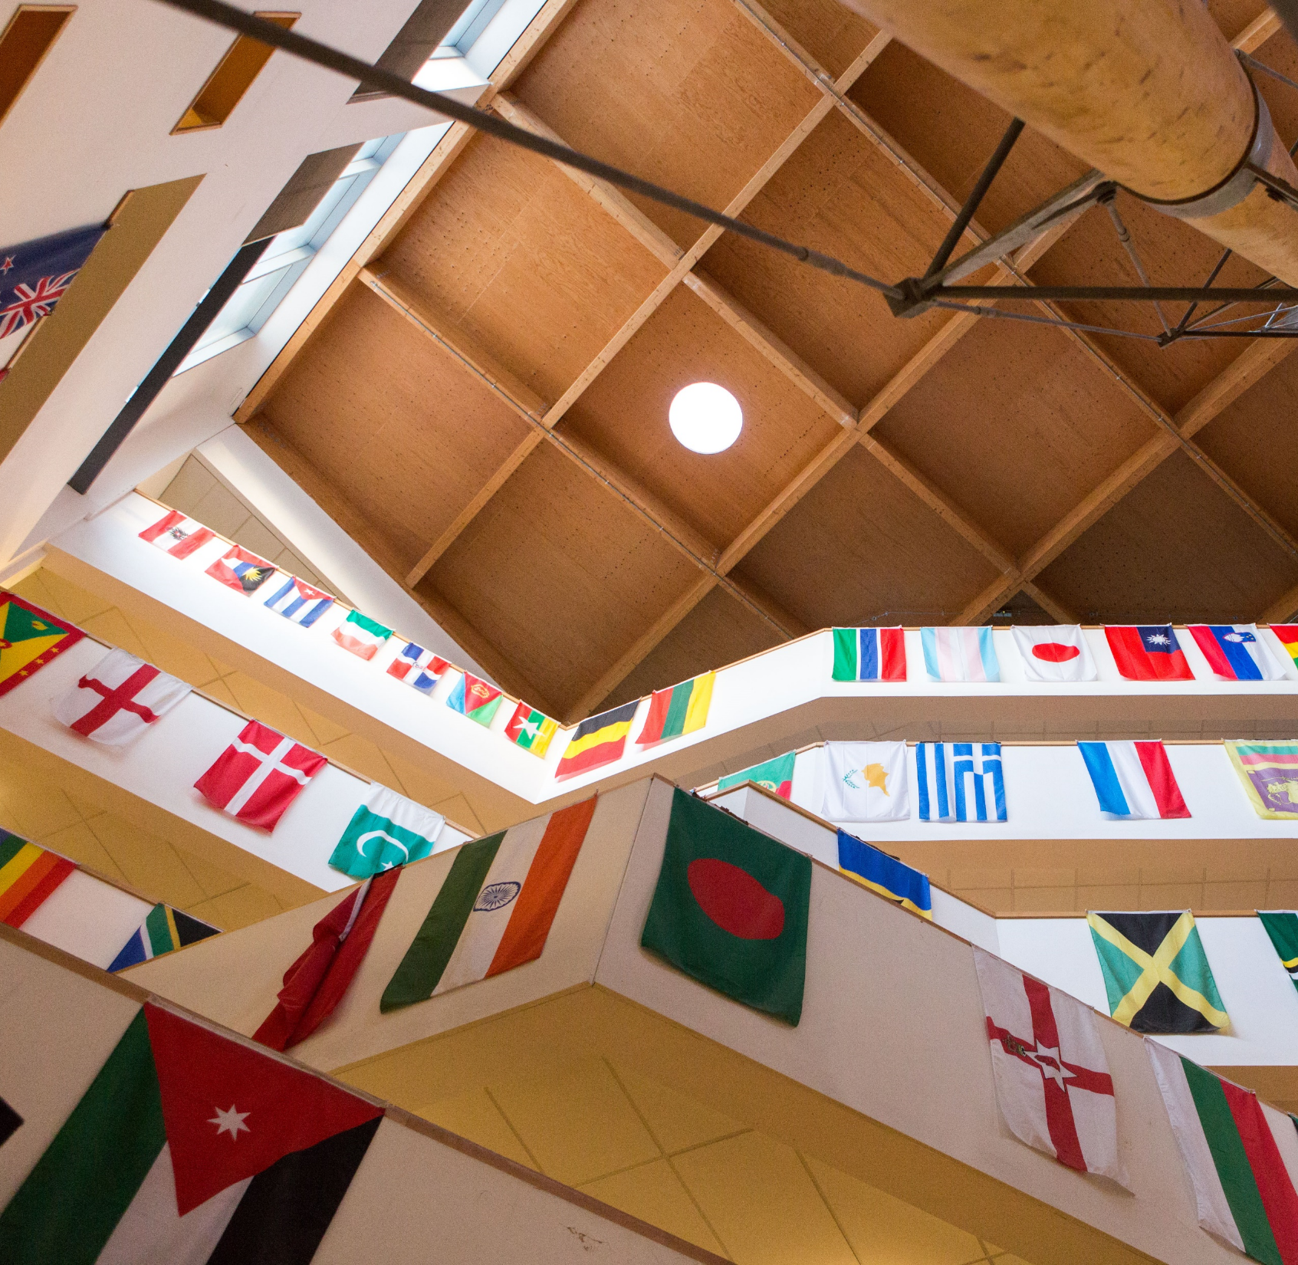
Do you speak another language?
Here is a competition for you.

Slide 2
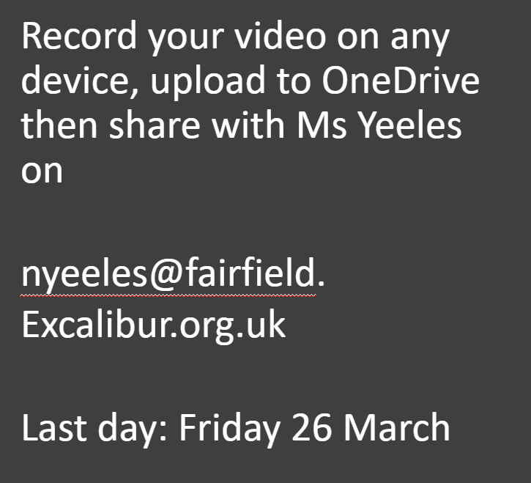
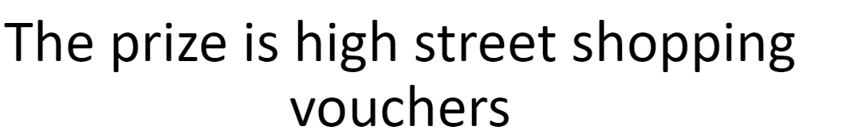
Do you speak another language?
There is a selfie film competition coming soon.
Ask your tutor to show you the info powerpoints in English, Somali or Arabic

Slide 3
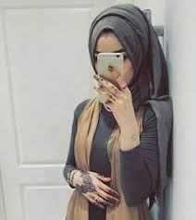
You will need to film yourself....

Slide 4

Speak first in the other language ​
and then in English​

Slide 5

say 3 things about yourself
talk about something you like about Fairfield
talk about something you would like to change – an idea to improve the school
ask a question about school to the people watching you

Slide 6

The film should be under 2 minutes long
We will look for creativity, language accuracy and ideas

Slide 7

The prize is high street shopping vouchers

Slide 8

Record your video on any device, upload to OneDrive then share with Ms Yeeles on
nyeeles@fairfield.
Excalibur.org.uk
Last day: Friday 26 March

